Slide 1

As of October 13, 2020
178,014 a/f stored in Pueblo
132,470 a/f of Project water
42,752 a/f of excess capacity water
2,959 a/f of winter water
109,944 a/f of Project space in Pueblo
30,368 a/f of Project space in Twin & Turquoise
Notes:
Stored in Pueblo= Actual on daily
Project Water on daily
Excess Cap water=all ST and LT accounts (ctl br on ACCOUNT MASTER date, sum content, subtract ww and proj water)
Winter water = winter water + winter water carryover
Proj Space= res prj space– project water

Slide 2
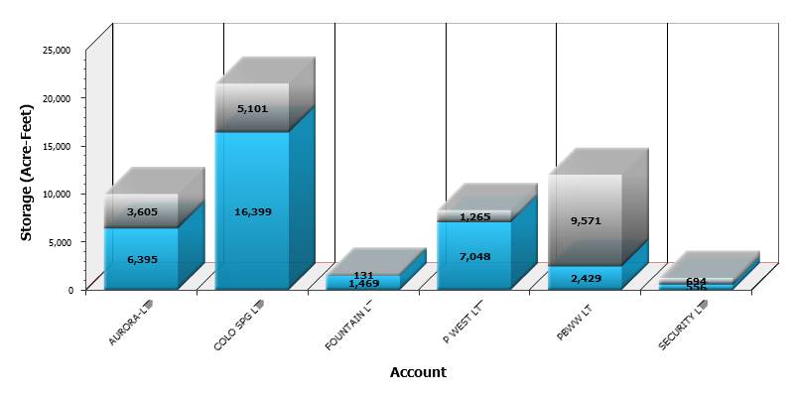

Slide 3
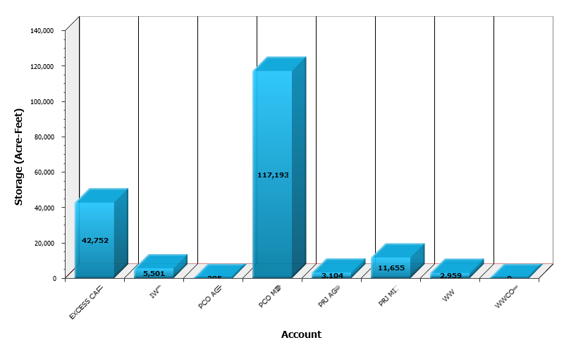

Slide 4
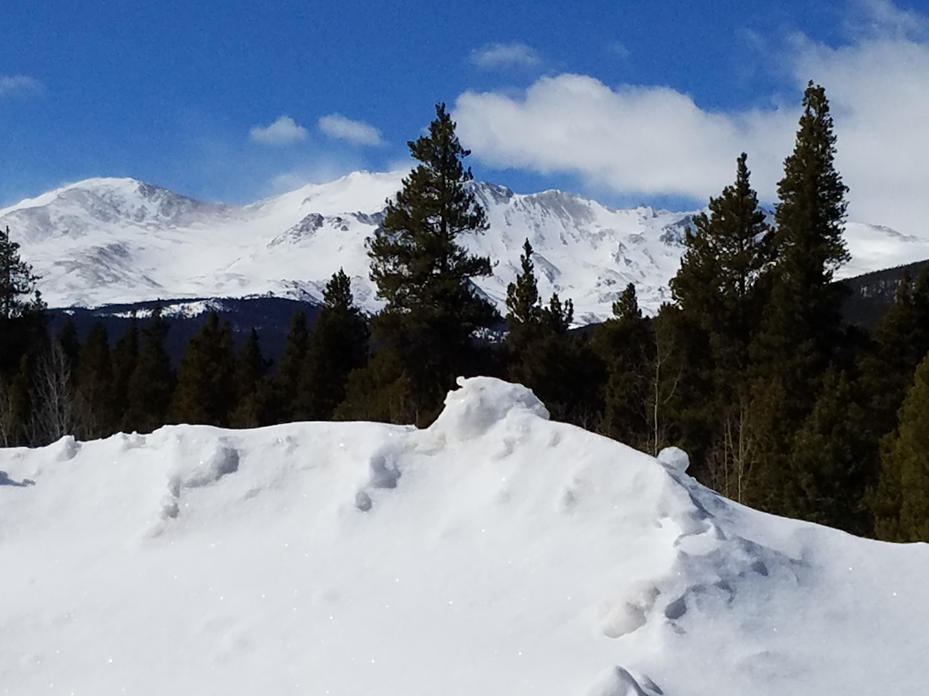
2019-2020
Winter Water
Stored in Pueblo
43,866 AF
Average Total
43,302 AF

Slide 6
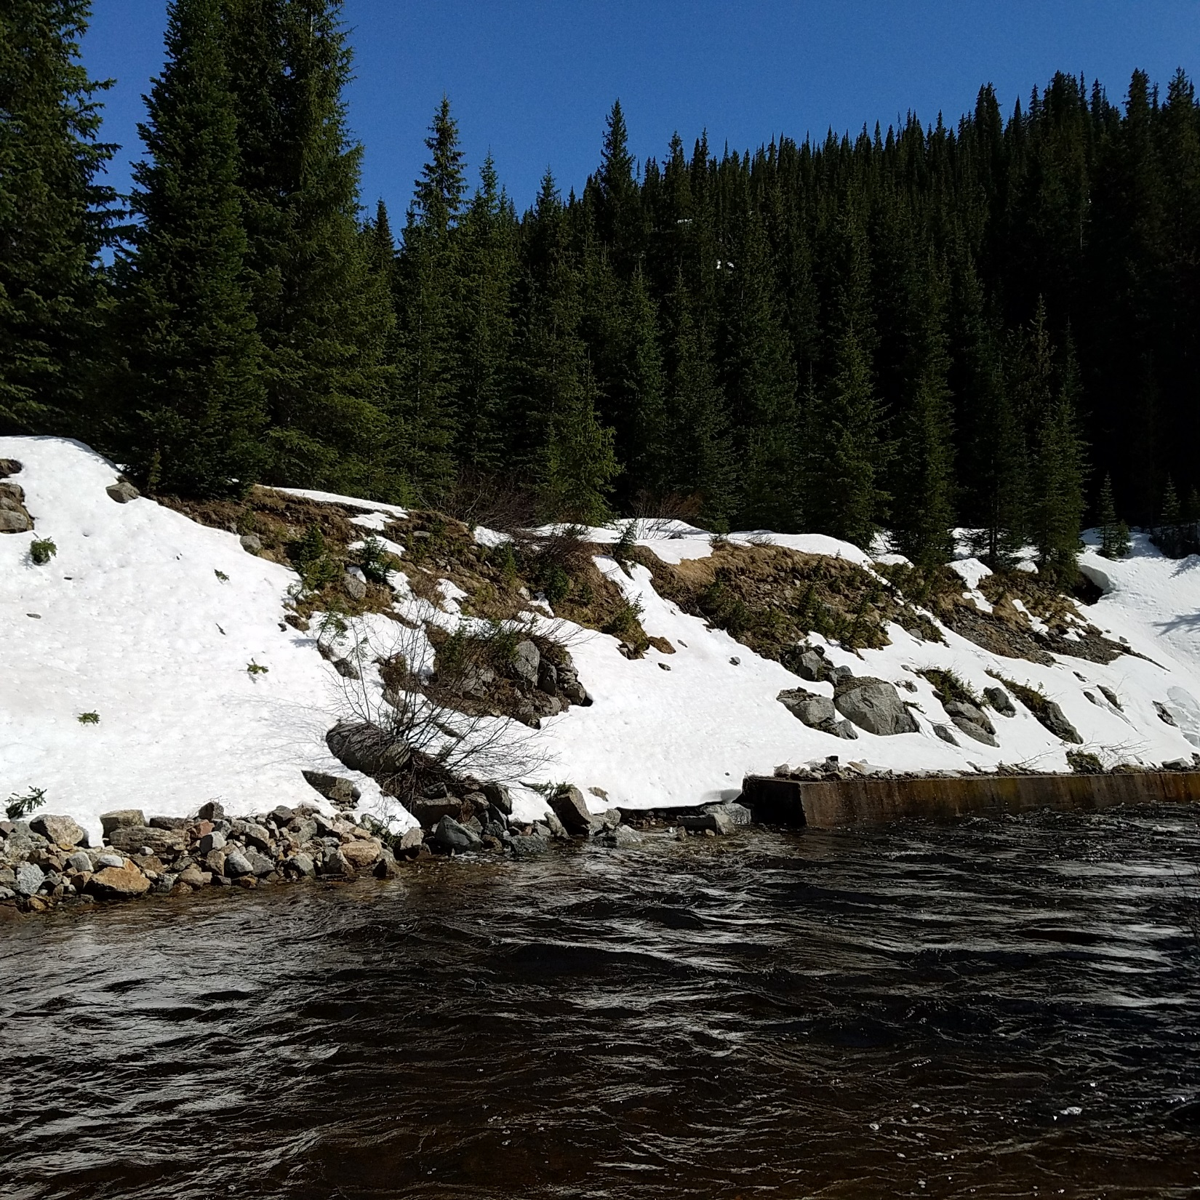
Storage
As of October 13, 2020
Turquoise 88%
Twin Lakes 90%
Pueblo 113%

Slide 8

Winter Operations
Anticipate moving around 26.7 KAF down from the upper reservoirs beginning mid-Nov. Net 24 KAF in Pueblo
Winter water ends March 15
Use of Joint Pool ends April 15
After April 15, all winter water will be stored up 70 KAF plus what room is available after project and Spill 4 water is accounted for
Winter and Prj Ag water out by May 1
Movement of water will be adjusted according to the forecast and customers needs

Slide 9
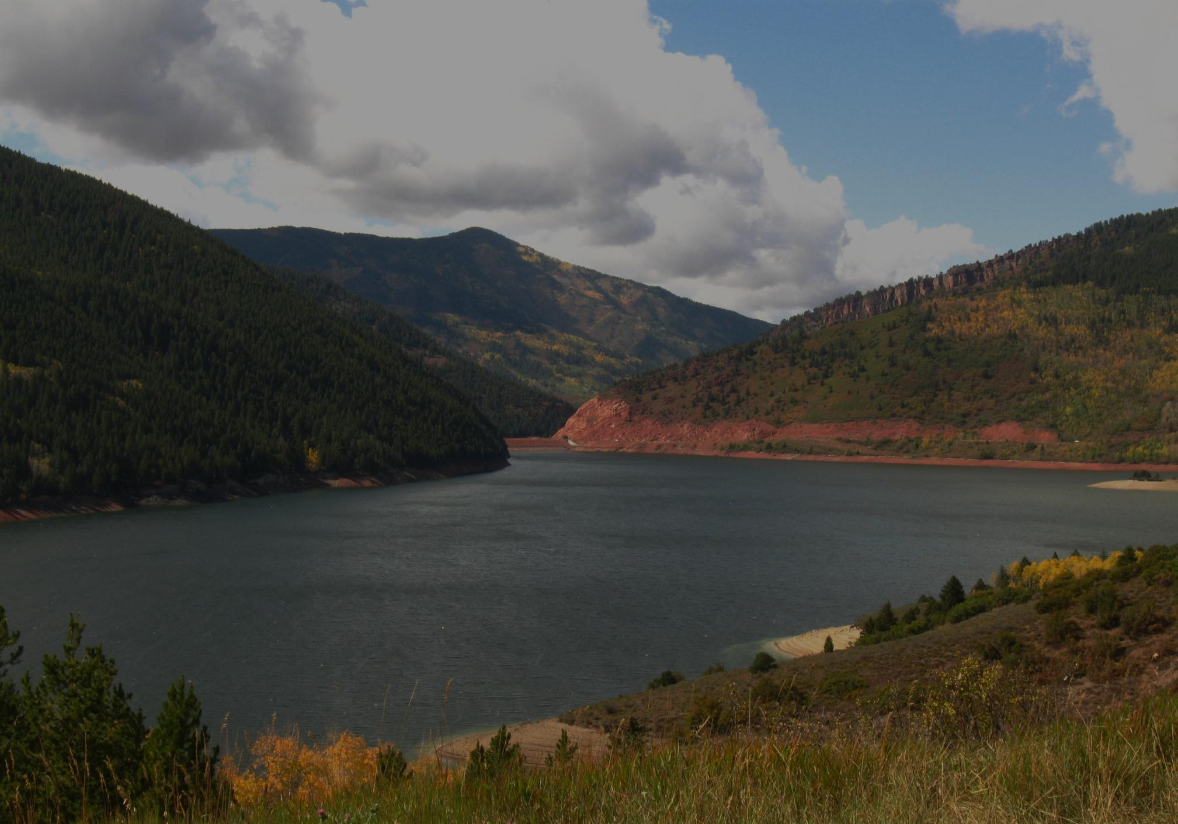
CONTENT 178,014
+ New WW 43,000
+ Project Water 24,000
+ M&I Inflow 24,500
- Total Releases 17,150 (no releases in anticipation of a spill included)
- Evap 5,000
APRIL 15 247,364– 245,373= 1,991 AF
spill
OUT BEFORE MAY 1
- 2020 W.W. 2,959
- 2020 Ag. Proj. W. 3,104
259,402 – 245,373 = -4,072 AF
no spill
*Winter water storage is subject to Article 13 of the USBR/SECWCD contract

Slide 10
Spill Priorities Article 13 of the SECWCD/United States Contract.
Sub article 13.(a) Whenever water is evacuated from Pueblo, Twin Lakes, and Turquoise Reservoirs to meet the necessities of Project flood control, generation purposes, storage of trans-mountain Project water, or native Project water, and operational requirements; except as provided in Subarticle 13.(b) below, the water evacuated shall be charged in the following order:
1. Against water stored under contracts for if-and-when available storage space for entities which will use the water outside the District boundaries.
2. Against water stored under contract for if-and-when available storage space for entities which will use the water within the District boundaries.
3. Against any winter storage water in excess of 70,000 acre-feet.
4. Against water stored under contracts with municipal entities within the boundaries of the District, which water is neither Project water nor return flow from Project water and which is limited to 163,100 acre-feet, less any Project water purchased and stored by municipal users. This evacuation will be charged pro rata against all water stored under such like contracts at the time of evacuation.
5. Against winter storage water not in excess of 70,000 acre-feet.
Project water does not spill!

