Slide 1
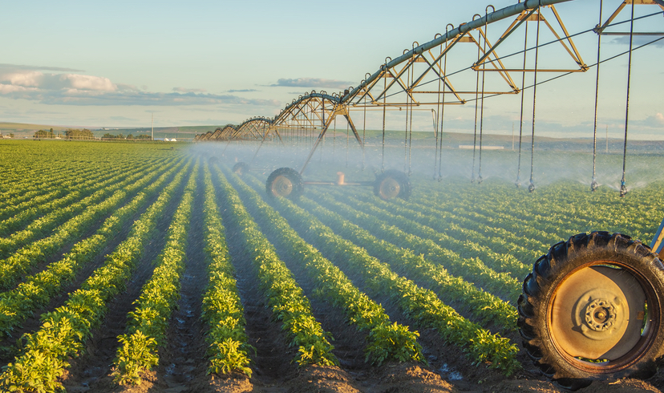
Agricultural First Right of Refusal
A Look at a Sustainable Future
Notes:
Good morning. Thank you for coming!

Slide 2
Agricultural First Right of Refusal
Goals
Finalize the Agricultural First Right of Refusal Fort Lyon Pilot Project with a Program that allows our ag stakeholders to use their Agricultural First Right of Refusal
Amend the Southeastern Colorado Water Conservancy District Fryingpan-Arkansas Project Water Return Flow Policy to Reflect the Necessary Changes for the Program
Notes:
We are here this morning to talk about
we are finishing the Fort Lyon Pilot Project to allow all ag stakeholders to have a permanent program. How do we do that? By changing the District’s RF Policy to reflect those changes

Slide 3
Outreach Timeline
Stakeholder Meetings (Nov-Dec 2021)
  North of Pueblo (FVA)
  East of Pueblo
  West of Pueblo
  Pueblo
Review Feedback from Stakeholders with the Committee and make Necessary Changes (Jan 2022)
Committee Approve the Amended Fryingpan-Arkansas Project Water Return Flow Policy (Feb 2022)
Board Approve the Amended Fryingpan-Arkansas Project Water Return Flow Policy (Feb 2022)
Notes:
Given that we are amending the District’s RF policy, we needed to have meetings to inform our stakeholders. The meetings were broken up in the 4 geographical locations listed on the screen.
The next steps are to have work sessions with the committee and in February, we will approve the RF policy at the committee and board level

Slide 4
Today’s Agenda
Project Area
Fort Lyon Pilot Project
Scenario Planning
Usage Study
Proposed Program
Notes:
Project Area
A map of the area we are looking at
Fort Lyon Pilot Project
Where it all began
Scenario Planning
How we were able to look District Wide
Usage Study
Balance between Rule 10 and Rule 14
Proposed Program
The allocation process we’re implementing

Slide 5
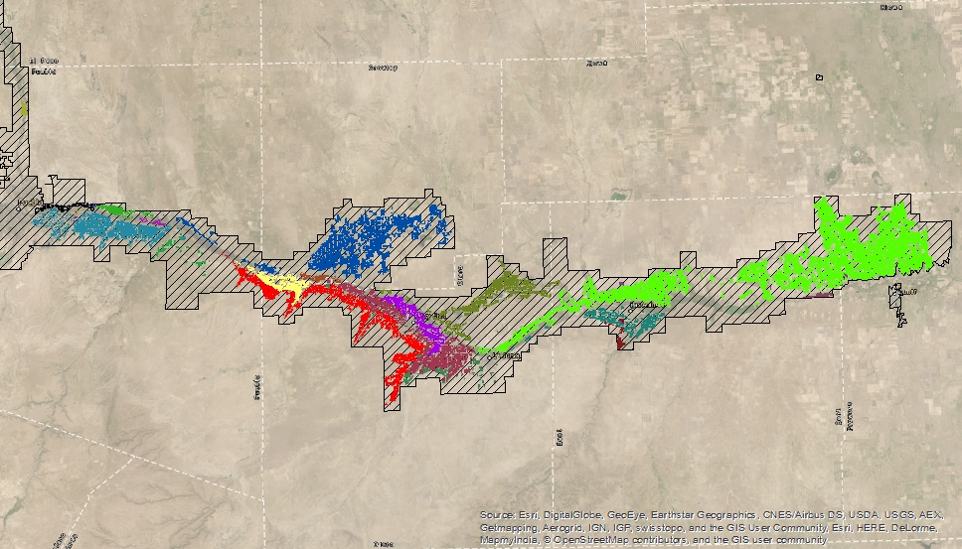
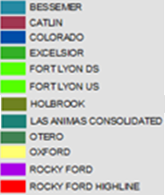
Irrigated Acreage in District
Produce administrable return flows because they are in the HI model
Notes:
This is a map of the irrigated acres from Pueblo Reservoir to Lamar. The Hatched area is the District boundaries. Each color on the map is the irrigated acreage for each ditch company. This is the project area because these are the only ditches we receive return flows from due to the HI model. As of now, this is the only area that is affected by the proposed policy changes.
Call out Bessemer, Colorado, Highline, and Fort Lyon

Slide 6
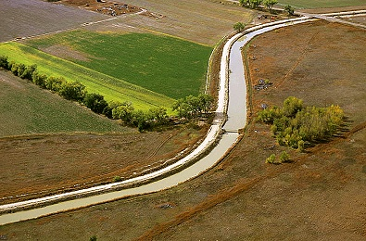
Where it began: Fort Lyon Pilot Project
The Enterprise began a Pilot Project in 2014 investigate the feasibility of a future District-wide plan to ensure that returns flows are allocated equitably and maximize utilization of all Fry-Ark Project water and Return Flows

Slide 7
Who Participated: Fort Lyon Pilot Project
Fort Lyon Canal Company
  2014-2021
  Used Return Flows to offset depletions of Well Augmentation and Irrigation Efficiency of FLCC Members
Oxford Ditch
  2019-2020
  Used Return Flows to pump Company Wells into Ditch for Ditch wide Benefit
Rocky Ford Highline Canal
  2019-2021
  Used Return Flows to pump Company Wells into Ditch for Ditch wide Benefit
What about District Wide?
  Scenario Planning
Notes:
The Fort Lyon was in the pilot program from the beginning of the pilot to last year. RFs generated by FL, Used by only FL members, and were used for both Rule 14 and Rule 10. The Oxford and Highline had headgate wells; or wells that pumped into the ditch for all members to use; and offered a different picture on how RFs can be used. However not all the ditch companies in the District are able to use RFs the same way each of these ditches were able to. So instead of running a new ditch each year, we turned to modeling to understand what different programs did to each ditch and was referred to as scenario planning.

Slide 8
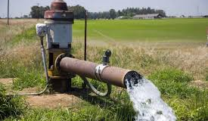
Wilson Water Group
Scenario Planning
Understand the impacts of different policy decisions on Return Flow allocation
  Allow Rule 10
  Allow RF from entire ditch
Beneficiaries
  Looked at using Return Flows for Rule 14 and Rule 10
  Looked at using Return Flows from Lands that are not Rule 14 and Rule 10
Equity
  Looked at limiting only Return Flows in a Ditch and Return Flows from Surface Only Lands
Administration
  Looked at how DWR would administer/ accountant for Return Flows.
Notes:
So there were a couple provisions in the CURRENT RF policy that did not allow for RFs to be used for Rule 10 and an AFRR could only use RFs from the lands that generated them, not the entire ditch company. So the scenarios looked at certain ways to apply the AFRR and flipped those switches on and off to see what it affected.
But how do we measure how effective each scenario was. Well, there were 3 metrics that we thought were imperative to keep whole. FOLLOW SLIDES

Slide 9
Irrigated Acreage in District
Produce administrable return flows because they are in the HI model
Notes:
So lets take a look at the map again to get a better visual. This map shows all the acres able to produce return flows.

Slide 10
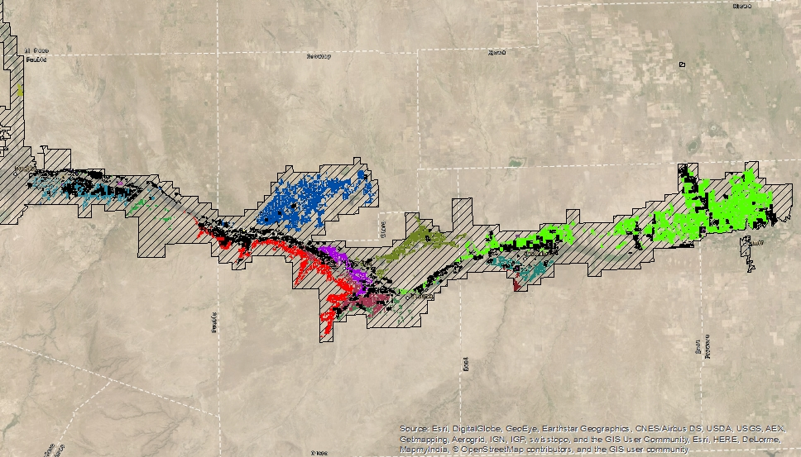
Irrigated Acreage in District
Black acres are also served by an augmentation provider
These acres can receive Project return flows
Notes:
However, in the black, are only the acres that can use the Project water RFs. And depending on the scenario, or way the AFRR is applied, changed the results. Lets take a look at a couple scenarios.

Slide 11
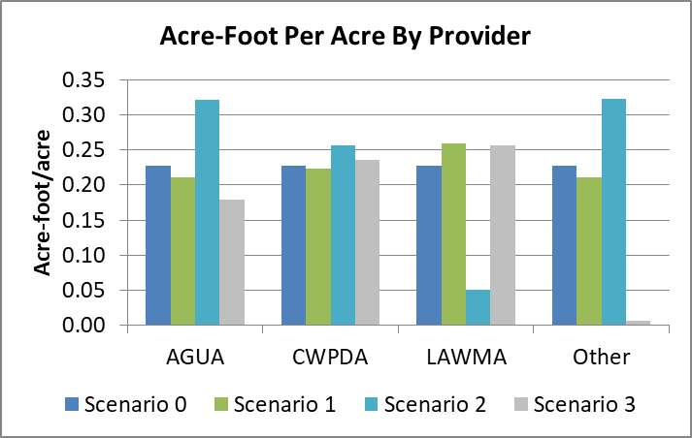
All Ditches Run Fort Lyon Pilot Project
Beneficiaries:
Supplemental eligible augmentation acres under each ditch
Equitable:
All agricultural users exercise 1st right of refusal. Changes the distribution of return flows between individual ditches and the augmentation providers.
2,222 sole-source groundwater acres in augmentation plans are unable to receive Project return flows.
  For example: Excelsior and sole-source wells
Administration:
District must be involved with ditch administration to understand where Project surface water and return flows are allocated.
Each “Return Flow Bucket” requires
a 20-year model for the State to administer
the return flows. If the State refuses to take
on the additional modeling, who takes on
the engineering and financial burden?
Provider | Combined
AGUA | 0.18
CWPDA | 0.24
LAWMA | 0.26
Other | 0.01
Ditch | AF/acre
Bessemer | 0.16
Colorado | 0.17
Rocky Ford Highline | 0.53
Oxford | 0.10
Otero | 1.77
Catlin | 0.18
Fort Lyon | 0.26
Holbrook | 0.45
Notes:
The first scenario was applying the FL pilot project to the entire District. As you can see from the tables, each ditch benefitted but the sole source wells stuggled; however, in terms of equity, this drastically changed the “winner and losers” of the RF and drastically moves away from the equity of how we allocation First Use Project Water. Lastly, since every ditch has a different distribution, the DEO would go from one model before the Pilot Project to 8 or more models to try capturing all the accounting. This is a hard sell basin wide.

Slide 12
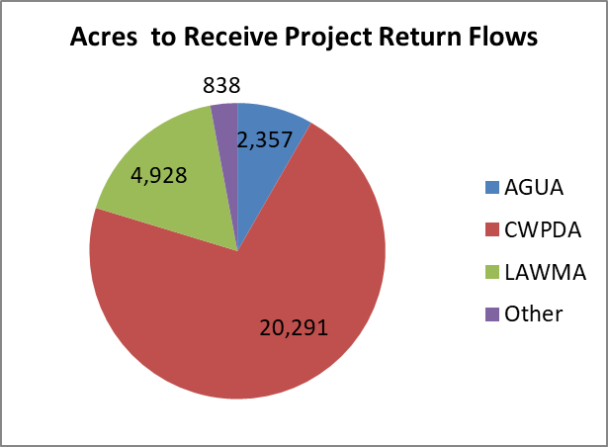
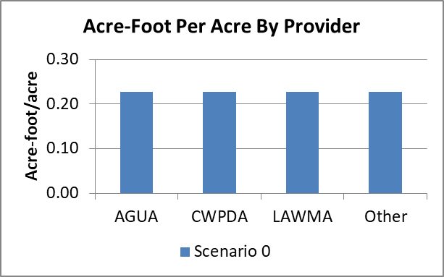
Allocation By Farm Unit
Type | Acres | Percent | Volume | AF/acre
AGUA | 2,357 | 8% | 536 | 0.23
CWPDA | 20,291 | 71% | 4,618 | 0.23
LAWMA | 4,928 | 17% | 1,122 | 0.23
Other | 838 | 3% | 191 | 0.23
Total | 28,414 |  | 6,467
Beneficiaries:
All eligible augmentation acres
Equitable:
Augmentation providers receive a volume of return flow proportional to the acreage they serve. Therefore, the acre-foot/acre allocation is the same.
Agricultural users do not have a 1st right of refusal.
Administration:
District to assign specific allocations based on farm unit.
Augmentation providers must track return flows by farm unit (currently done by CWPDA).
No increase in administration/accounting to the State.
Notes:
One of the later scenarios we looked at was an allocation by Farm Unit, not by ditch. A “farm unit” is “a field or group of fields that have common wells, irrigation efficiencies, and a landowner or land user under a common ditch.”
This still doesn’t address adding Rule 10, or irrigation efficiencies.
In this scenario, all available beneficiaries received an allocation of water. Each beneficiary received the same AF/ac allocation. And the Farm Unit is how the DEO account for groudwater currently, so we adopt their system since DEO accounts for the water.

Slide 13
Irrigated Acreage in District
Black acres are also served by an augmentation provider
These acres can receive Project return flows
Notes:
To better understand adding rule 10 to the mix, this map shows the acres that are irrigated by wells, like we saw before.

Slide 14
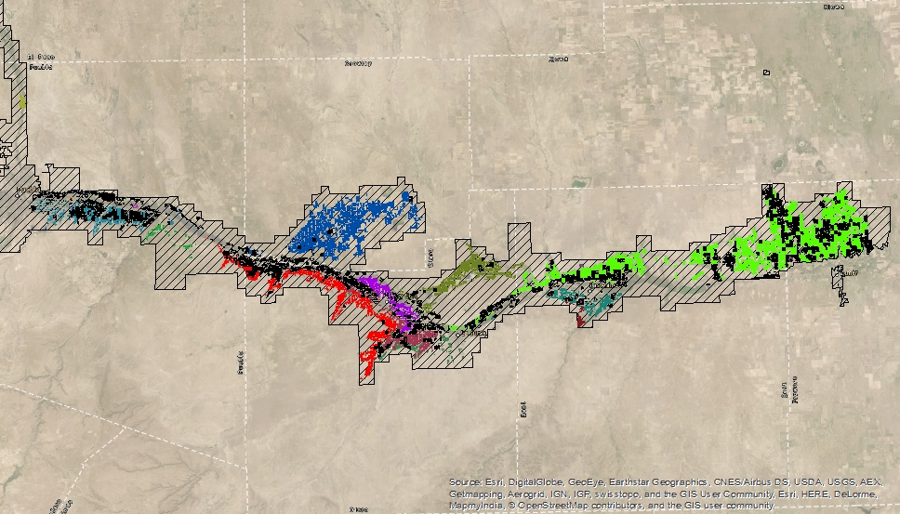
Irrigated Acreage in District
Black acres are also served by an augmentation provider
  AND/OR
  Are Rule 10 acres.
These acres can receive Project return flows
Notes:
This map shows the additional acres irrigated by wells and have irrigation improvements or Rule 10 acres. The ability to help replace Rule 10 depletions is just as necessary as Rule 14, but in the pilot, we were allocating water to Rule 10 that was more than their usage. So we turned to modeling again to help balance the allocation between Rule 10 and Rule 14.

Slide 15
Finding the Balance with the Next Era of Irrigation
  Wilson Water Group
    USE STUDY
  Irrigation Efficiency (Rule 10) depletions/or use are lower per acre than Well Augmentation (Rule 14)
  An adjustment will be applied to allocate based on how much water is used
Notes:
To protect the allocation to Rule 14 but also meeting the growing need of Rule 10, an adjustment will be made at allocation to equitably balance the allocation to usage.

Slide 16
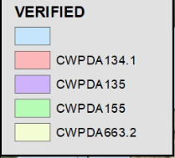
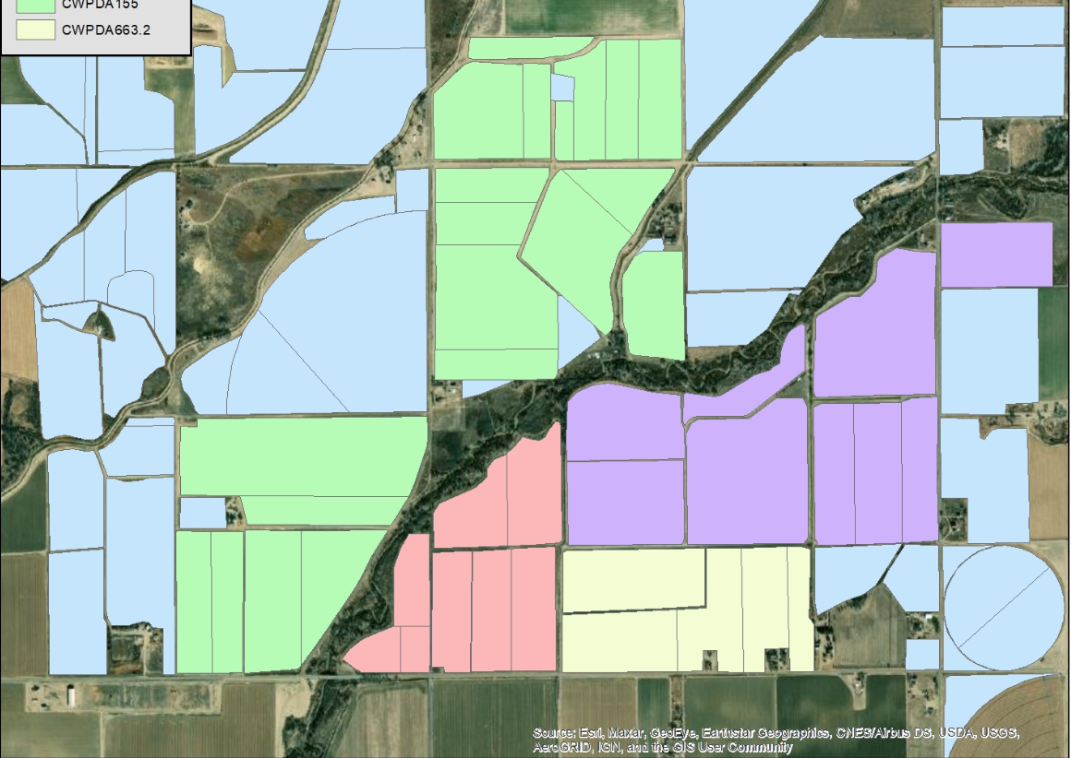
Proposed Program
Through the Pilot Program, District staff determined that the most equitable means of allocating agricultural Project Return Flows is to allocate the water to agricultural entities on a “farm unit” basis.
A “farm unit” is “a field or group of fields that have common wells, irrigation efficiencies, and a landowner or land user under a common ditch.”
Each RRA (Reclamation Reform Act) Eligible acre with a depletion will be eligible for a pro-rata allocation of Return Flows
Water will be treated as User-Supplied water to the Administering Organizations
  AGRA (AGUA/CWPDA), LAWMA, and LAVWCD
The change in the Return Flow Policy is to allow Rule 10 have an allocation equitably along with the historic allocation of Rule 14.

Slide 17
Outreach Timeline
Stakeholder Meetings (Nov-Dec 2021)
  North of Pueblo (FVA)
  East of Pueblo
  West of Pueblo
  Pueblo
Review Feedback from Stakeholders with the Committee and make Necessary Changes (Jan 2022)
Committee Approve the Amended Fryingpan-Arkansas Project Water Return Flow Policy (Feb 2022)
Board Approve the Amended Fryingpan-Arkansas Project Water Return Flow Policy (Feb 2022)
Notes:
As we take this information to the Committee and the Board in our work sessions, we will dive deeper into the detail of the pilot programs and the amended RF policy. If you want more detail, please come to the meetings.

Slide 18
Questions
Notes:
And as always, we are also available after the meeting or by phone and email if you have questions.

